Slide 1
Leveraging Business and Data Intelligence for Strategic Growth at Atliq Grands A Strategic Approach to Regain Market Share and Revenue

Slide 2
introduction
Overview of Atliq Grands:Properties: 15 five-star hotels across India
Experience: 20 years in the hospitality industry
Current Challenge: Decrease in market share and revenue due to competitive pressure and ineffective decision-making

Slide 3
Objectives of Data Intelligence Integration
Primary Objectives:
Increase Market Share: Target growth in luxury/business hotel segment.
Boost Revenue: Improve revenue per available room (RevPAR).
Enhance Guest Satisfaction: Raise average guest ratings.
Key Performance Indicators (KPIs):
RevPAR: Revenue per available room
Occupancy %: Percentage of occupied rooms
ADR: Average daily rate
Guest Satisfaction Ratings: Average ratings from guest feedback
Booking % by Platform: Percentage of bookings from different platforms (e.g., direct, OTA)

Slide 4
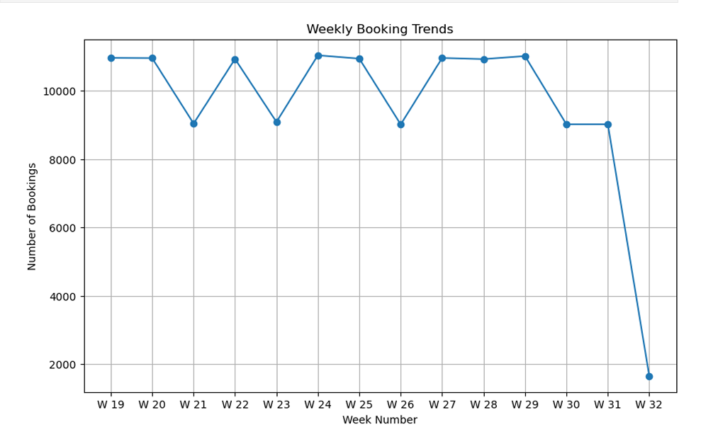
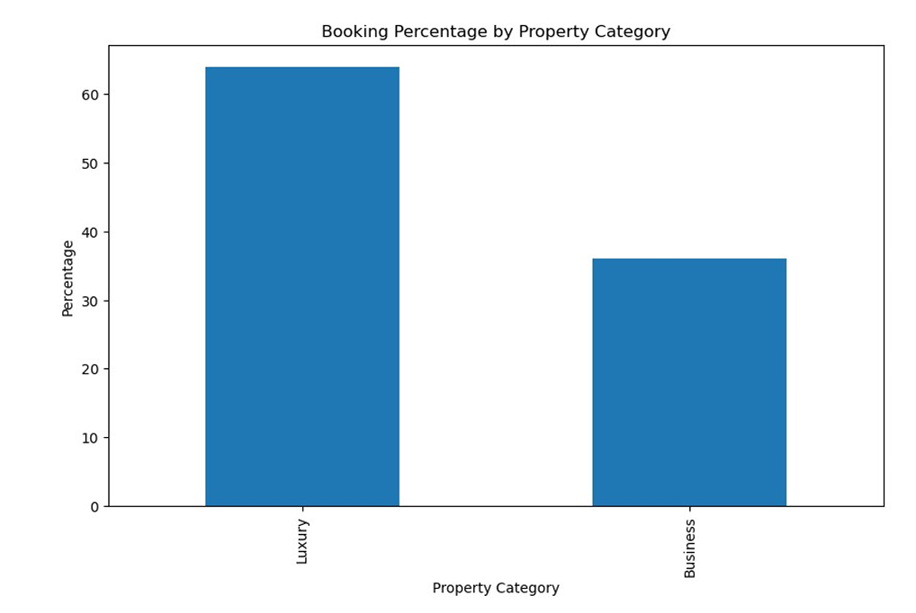
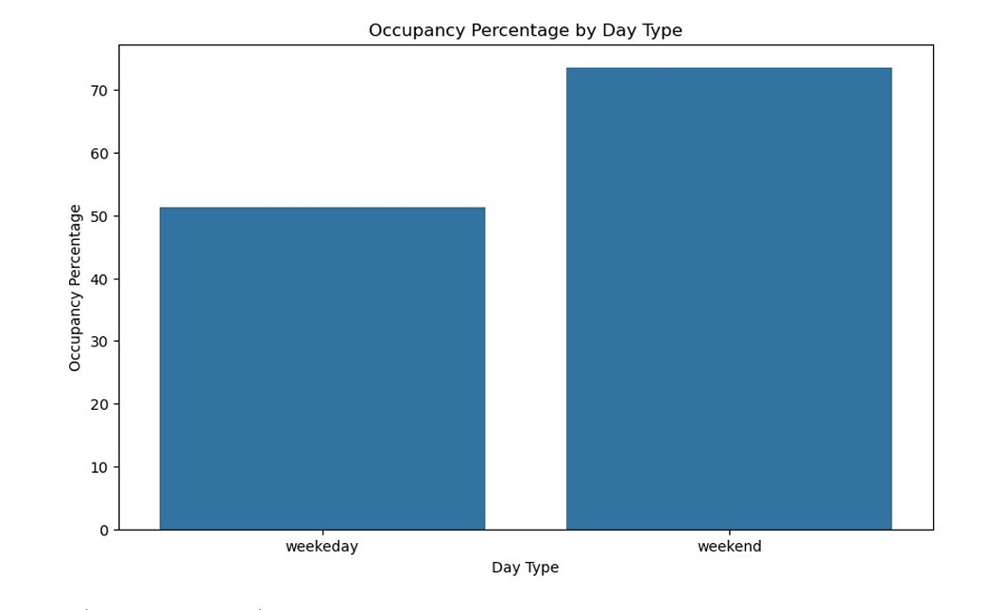
My Design

Slide 5
Thank you

